Slide 1

3.Monte Carlo Methods

Slide 2
Contents
Review : So far, MDP and Dynamic Programing
Monte Carlo (MC) method
Monte Carlo(MC) in RL
On-Policy MC
Code Ex.
Off-Policy MC
Code Ex.

Slide 3
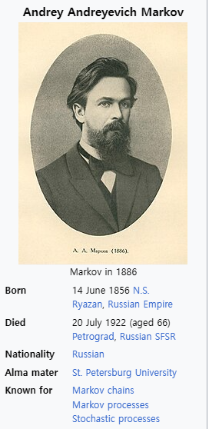
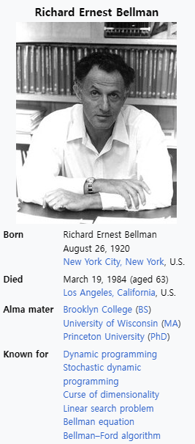
Review

Slide 4
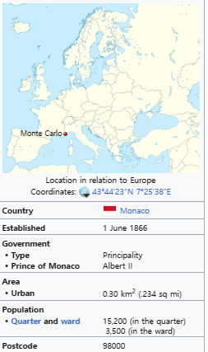
Monte Carlo

Slide 5
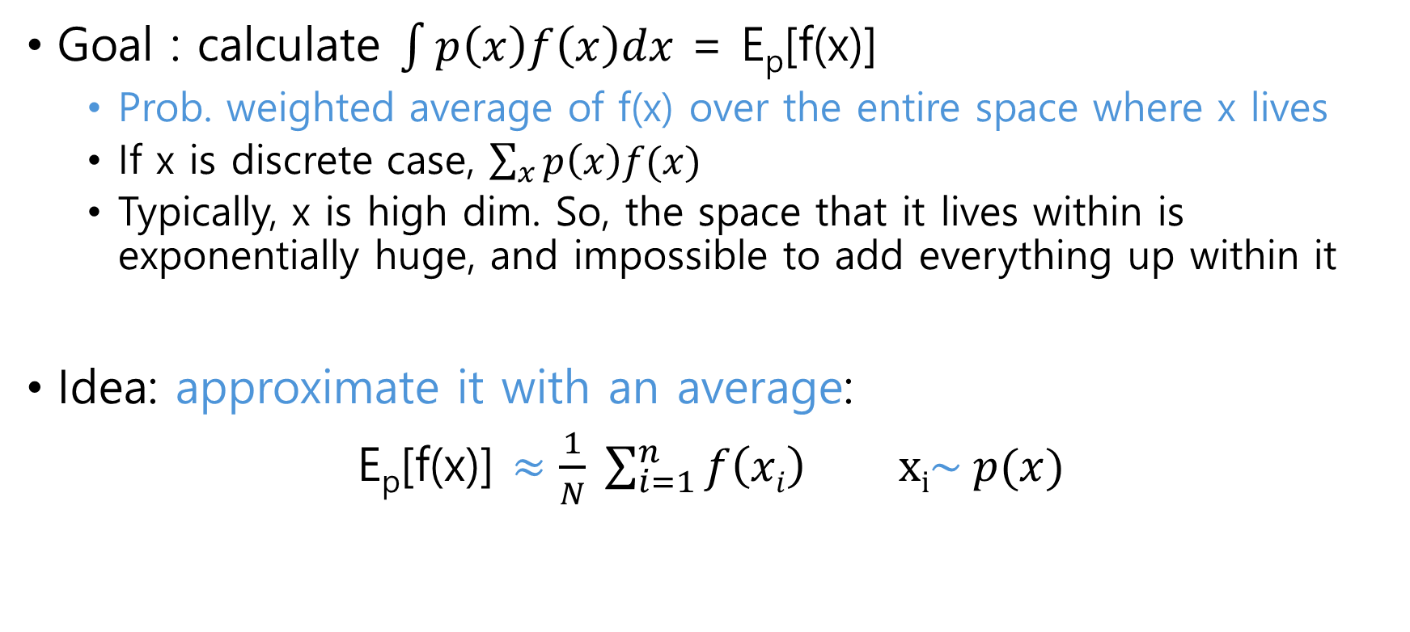
Understand MC estimation
Goal : calculate $\int{p\left(x\right)f\left(x\right)dx}$ = E_{p}[f(x)]
Prob. weighted average of f(x) over the entire space where x lives
If x is discrete case, $\sum_{x}{p\left(x\right)f(x)}$
Typically, x is high dim. So, the space that it lives within is exponentially huge, and impossible to add everything up within it
Idea: approximate it with an average:
E_{p}[f(x)] $≈\frac{1}{N} \sum_{i=1}^{n}{f\left(xi\right)} xi\sim p(x)$

Slide 6
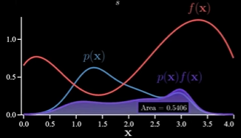
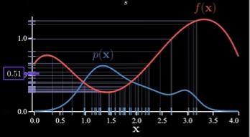
Understand MC estimation

Slide 7
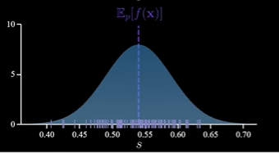
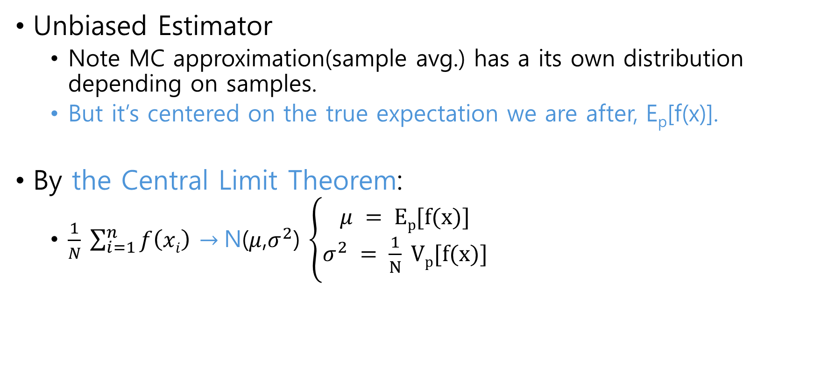
Understand MC estimation
Unbiased Estimator
Note MC approximation(sample avg.) has a its own distribution depending on samples.
But it’s centered on the true expectation we are after, E_{p}[f(x)].
By the Central Limit Theorem:
$\frac{1}{N} \sum_{i=1}^{n}{f\left(xi\right)}$ $→$N($μ$,$σ^{2}$) $\left\{\begin{aligned}μ = Ep[f(x)] \\ σ^{2} = \frac{1}{N} Vp[f(x)]\end{aligned}\right.$

Slide 8
Monte Carlo in RL

Slide 9

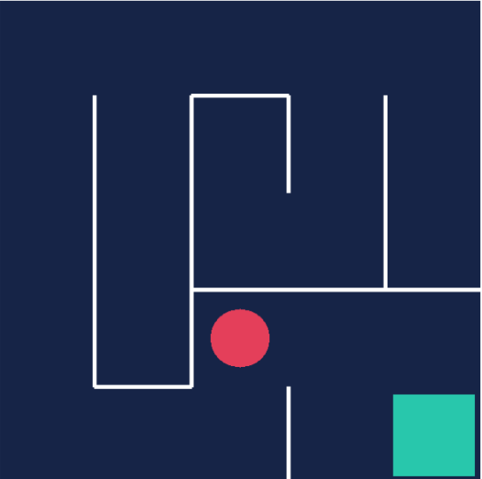
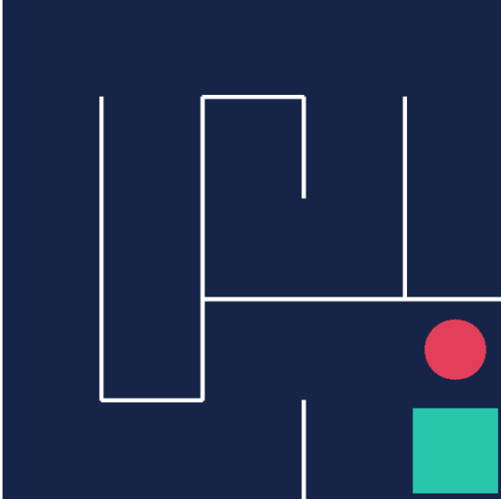
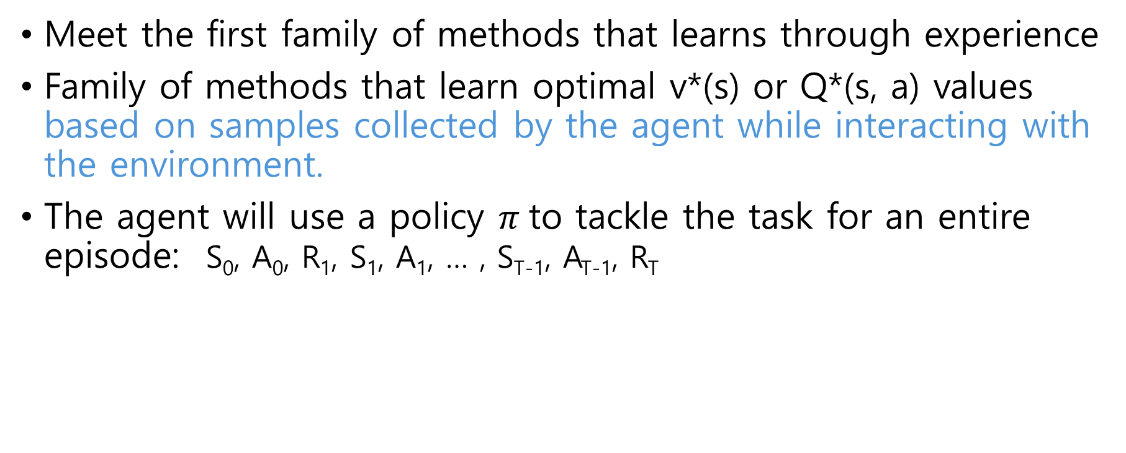
MC method in RL
Meet the first family of methods that learns through experience
Family of methods that learn optimal v*(s) or Q*(s, a) values based on samples collected by the agent while interacting with the environment.
The agent will use a policy $π$to tackle the task for an entire episode: S₀, A₀, R₁, S₁, A₁, … , S_{T-1}, A_{T-1}, R_{T}

Slide 10
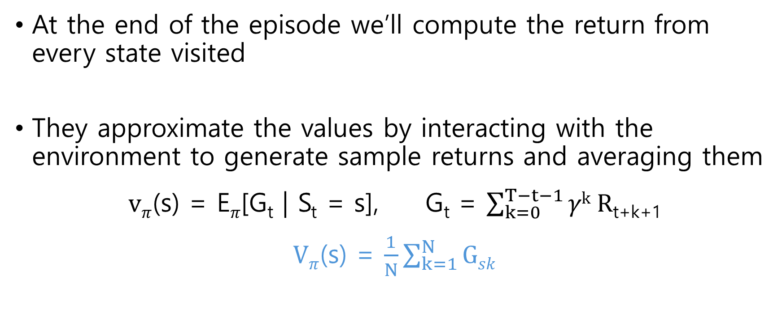
MC method in RL
At the end of the episode we’ll compute the return from every state visited
They approximate the values by interacting with the environment to generate sample returns and averaging them
$vπ$(s) = E$π$[G_{t} | S_{t} = s], G_{t} = $\sum_{k=0}^{T−t−1}{γk R}$_{t+k+1}
$Vπ$(s) = $\frac{1}{N}\sum_{k=1}^{N}{Gsk}$

Slide 11
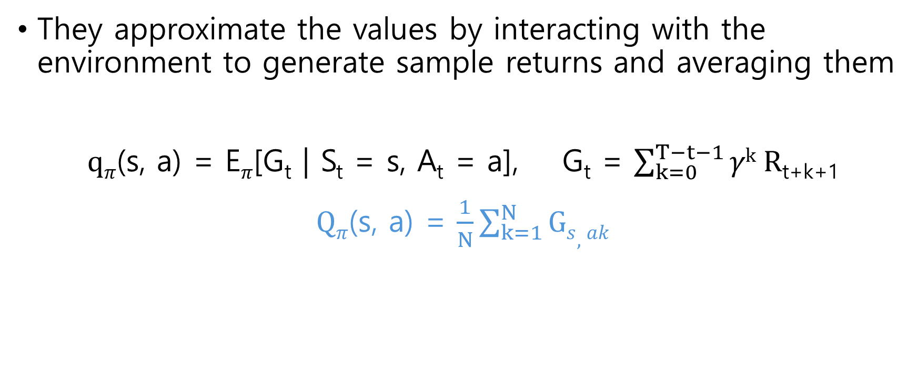
MC method in RL
They approximate the values by interacting with the environment to generate sample returns and averaging them
$qπ$(s, a) = E$π$[G_{t} | S_{t} = s, A_{t} = a], G_{t} = $\sum_{k=0}^{T−t−1}{γk R}$_{t+k+1}
$Qπ$(s, a) = $\frac{1}{N}\sum_{k=1}^{N}{Gs,ak}$

Slide 12
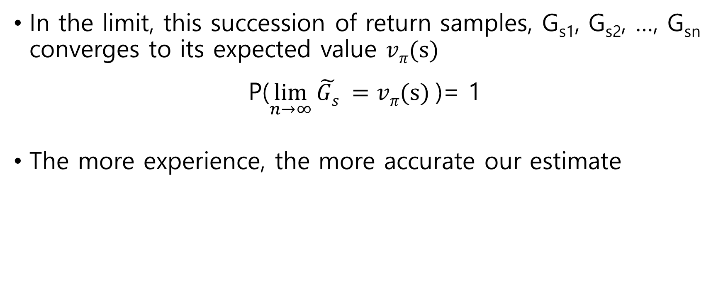
Law of large numbers
In the limit, this succession of return samples, G_{s1}, G_{s2}, …, G_{sn} converges to its expected value $vπ(s)$
P($\lim_{n→∞}{\tilde{Gs} =vπ(s)}$)= 1
The more experience, the more accurate our estimate

Slide 13
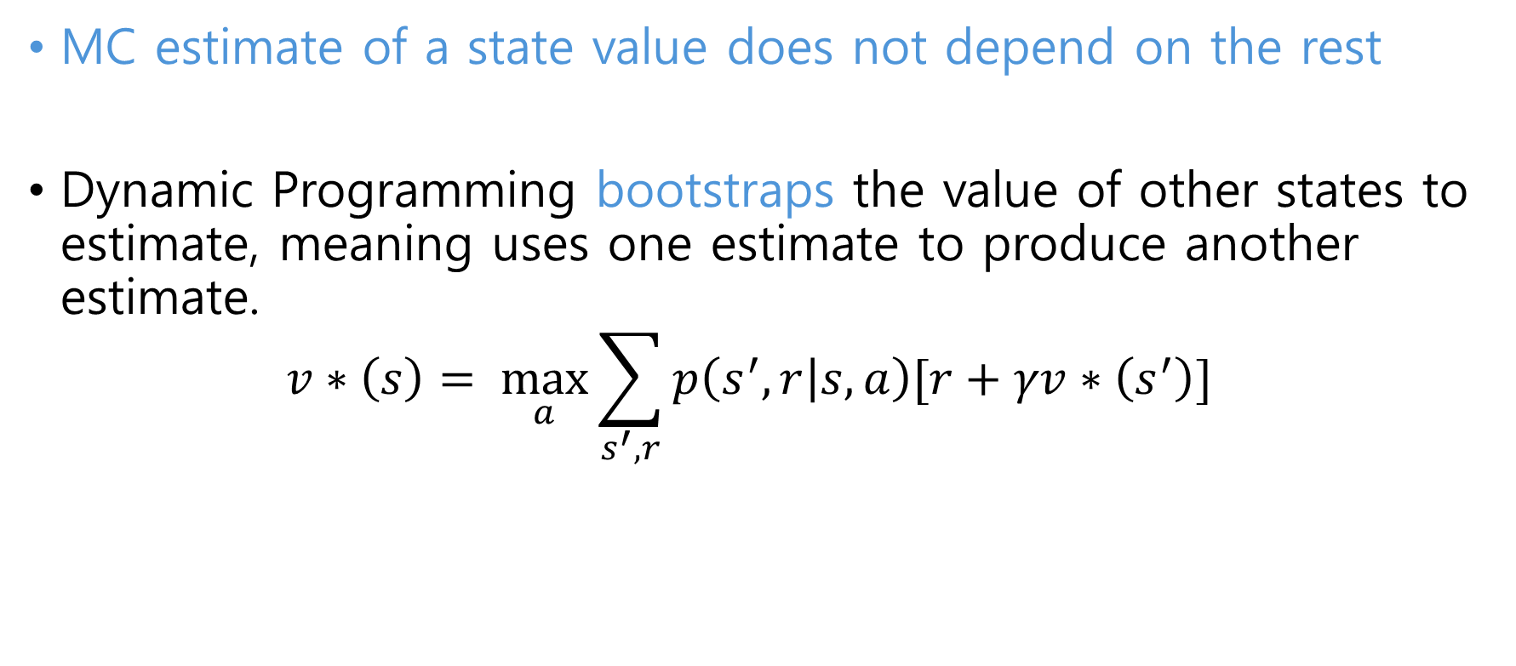
Advantages of MC
MC estimate of a state value does not depend on the rest
Dynamic Programming bootstraps the value of other states to estimate, meaning uses one estimate to produce another estimate.
$$v∗\left(s\right)= \max_{a}{\sum_{s^{′},r}{p\left(s^{′},r | s,a\right)[r+γv∗\left(s^{′}\right)]}}$$

Slide 14
Advantages of MC
The complexity of estimating the value of a state doesn’t depend on the number of states in the task
The cost of estimating a state value is independent of the total number of state
Dynamic Programming, the complexity of algorithms grows exponentially with the number of states

Slide 15

Advantages of MC
MC can focus its efforts on estimating correctly the value of states that lead to the goal
MC can focus the estimations on the states that help us solve the task
The states shaded in green are more important than the rest because they form the optimal path and therefore we want to focus our learning on them
Dynamic Programing sweeps through the state space and updates every single state whether they are important or not

Slide 16
Advantages of MC
MC don’t require the model of env.
No need to know the dynamics of the environment
Dynamics will be implicit in our estimates
Note Dynamic Programing requires the model of environment
For many tasks it is easier to generate samples than to model their dynamics

Slide 17
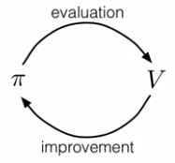
MC method in RL
Remember Generalized Policy iteration results in the following iterative process (template) :
Policy
Policy

Slide 18
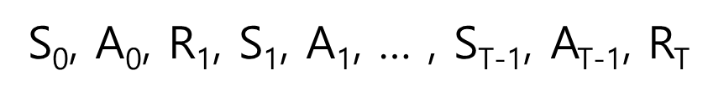
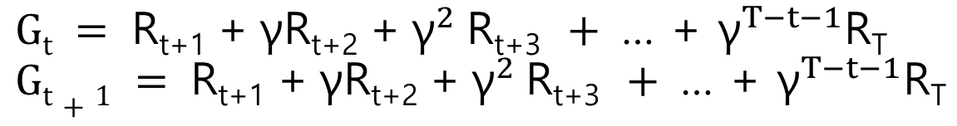
MC method in RL
The agent will face the environment using the initial policy for one whole episode form start to finish
From the generated trajectory, we will calculate the returns for each moment of time t :
….
….

Slide 19
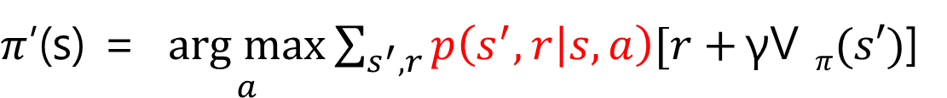
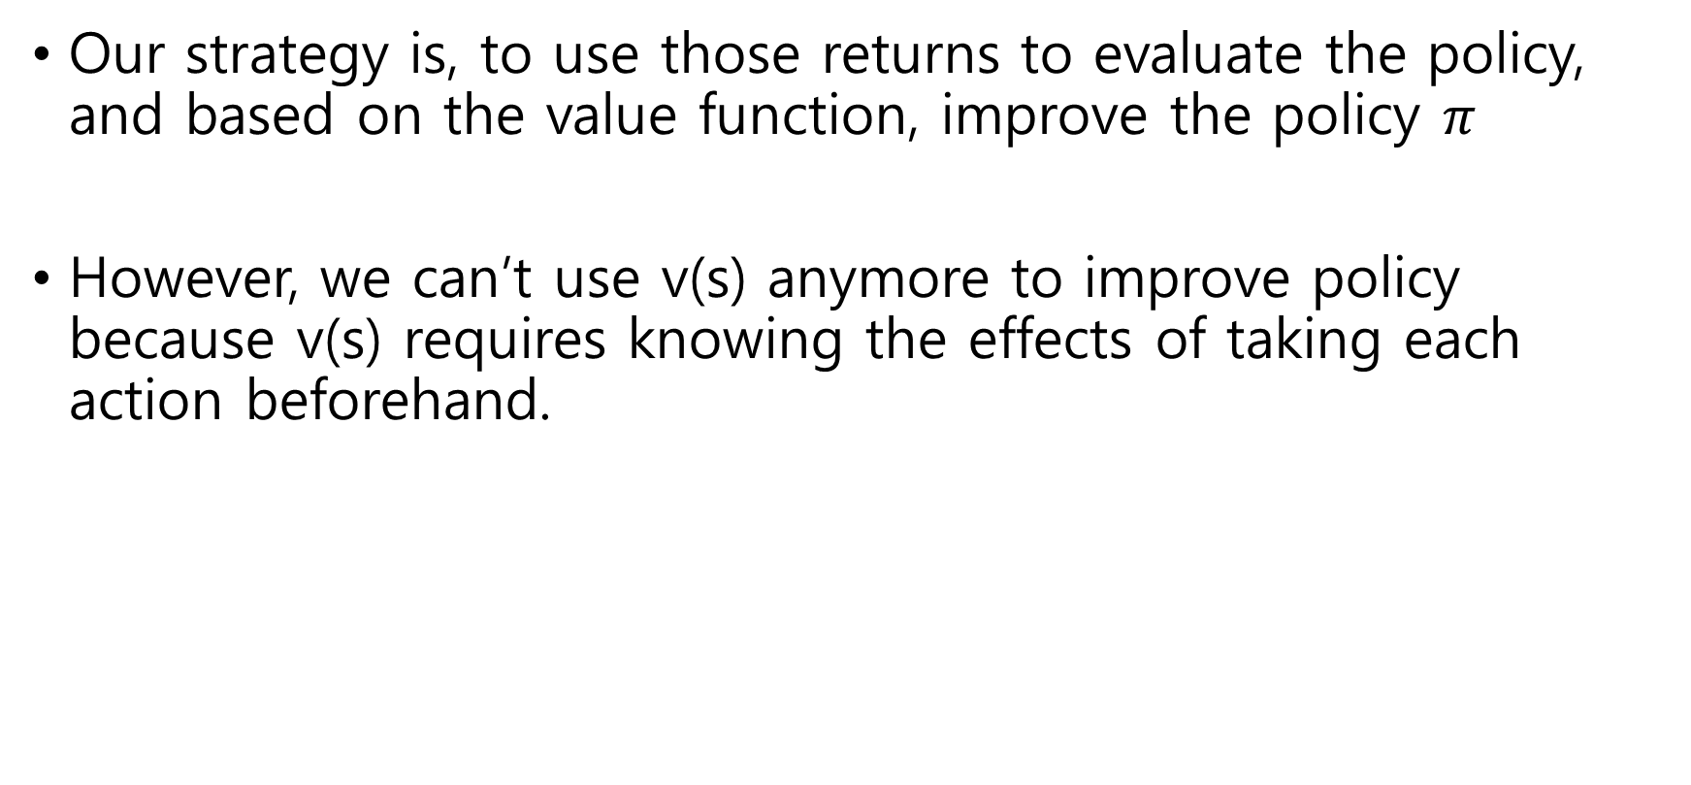
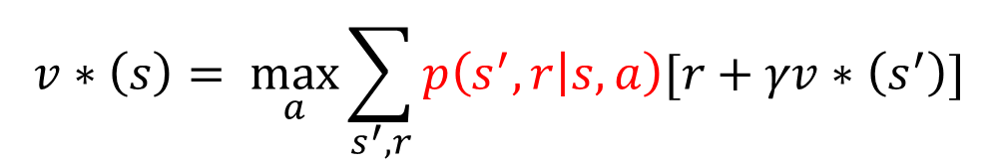
MC method in RL
Our strategy is, to use those returns to evaluate the policy, and based on the value function, improve the policy $π$
However, we can’t use v(s) anymore to improve policy because v(s) requires knowing the effects of taking each action beforehand.
$$v∗\left(s\right)= \max_{a}{\sum_{s^{′},r}{p\left(s^{′},r | s,a\right)[r+γv∗\left(s^{′}\right)]}}$$

Slide 20
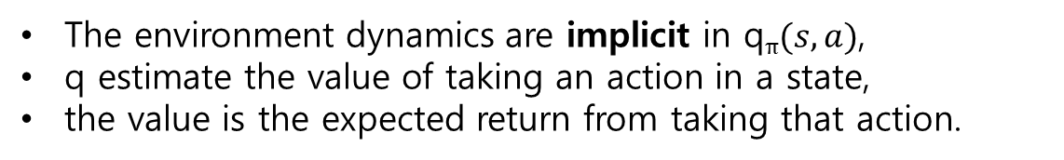
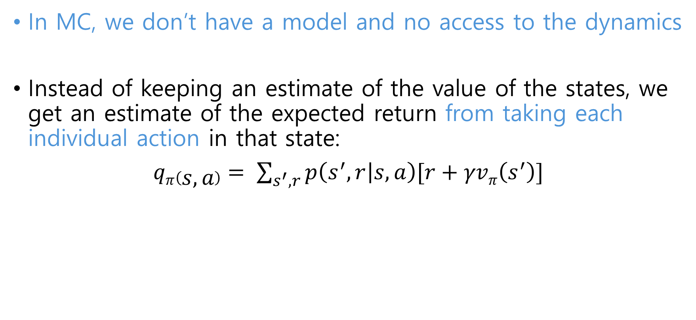
MC method in RL
In MC, we don’t have a model and no access to the dynamics
Instead of keeping an estimate of the value of the states, we get an estimate of the expected return from taking each individual action in that state:
$qπ\left(s,a\right)= \sum_{s^{′},r}{p\left(s^{′},r | s,a\right)[r+γvπ\left(s^{′}\right)]}$
The environment dynamics are implicit in q$π(s,a)$,
q estimate the value of taking an action in a state,
the value is the expected return from taking that action.

Slide 21
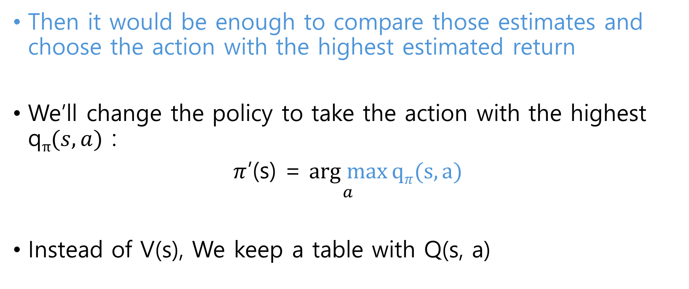
MC method in RL
Then it would be enough to compare those estimates and choose the action with the highest estimated return
We’ll change the policy to take the action with the highest q$π(s,a)$ :
$π$’(s) = $\underset{a}{arg max}{qπ(s,a)}$
Instead of V(s), We keep a table with Q(s, a)

Slide 22
MC method in RL
Policy
Q
Policy

Slide 23

Exploration

Slide 24
Exploration
However, for this strategy to work, we have to keep something in mind :
We now improve our policy based on the experience that the agent collects while interacting with env.
The experience that the agent collects depends on the actions it takes
Those actions depend on the policy that the agent is using at that time

Slide 25
Exploration
The estimates are poor especially in the early stage.
It will improve as we obtain new samples, but it might not be perfect
If a is optimal but Q(s, a) is low, we’ll never pick it.
The only way to correct this is to explore all actions every once in a while and update their estimate Q(s, a), so we do not leave a possible optimal action undiscovered

Slide 26
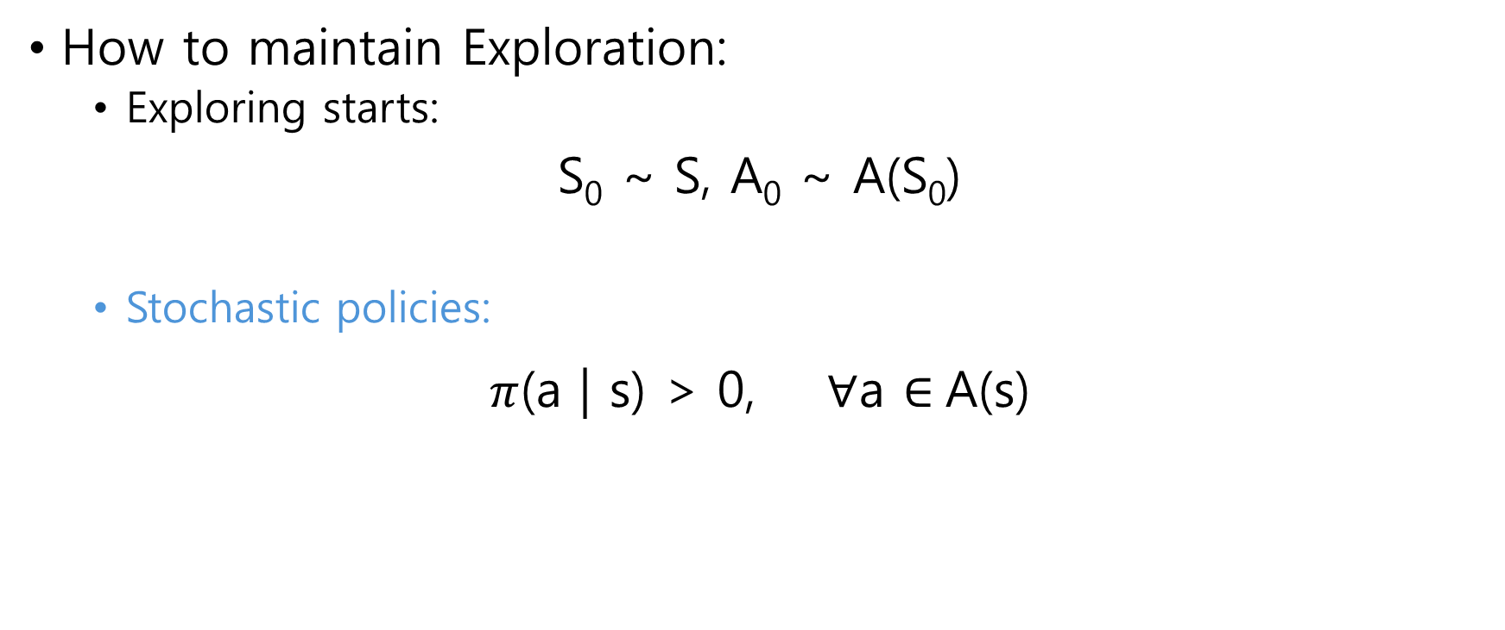
Exploration
How to maintain Exploration:
Exploring starts:
S₀ ~ S, A₀ ~ A(S₀)
Stochastic policies:
$π$(a | s) > 0, $∀$a $∈$A(s)
This ensures that from time to time, it takes an action that it doesn’t consider optimal to improve

Slide 27
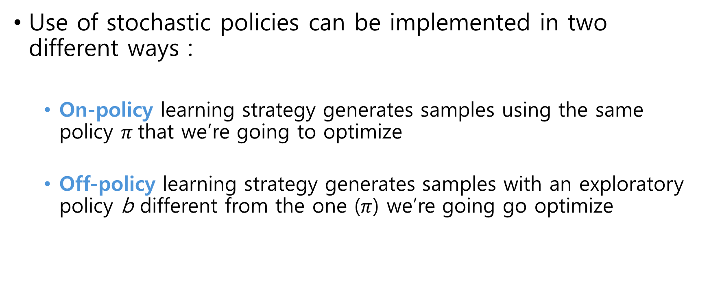
Exploration
Use of stochastic policies can be implemented in two different ways :
On-policy learning strategy generates samples using the same policy $π$that we’re going to optimize
Off-policy learning strategy generates samples with an exploratory policy b different from the one ($π$) we’re going go optimize

Slide 28
On-policy Monte Carlo

Slide 29
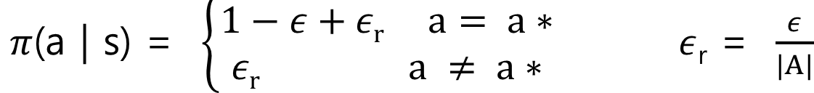
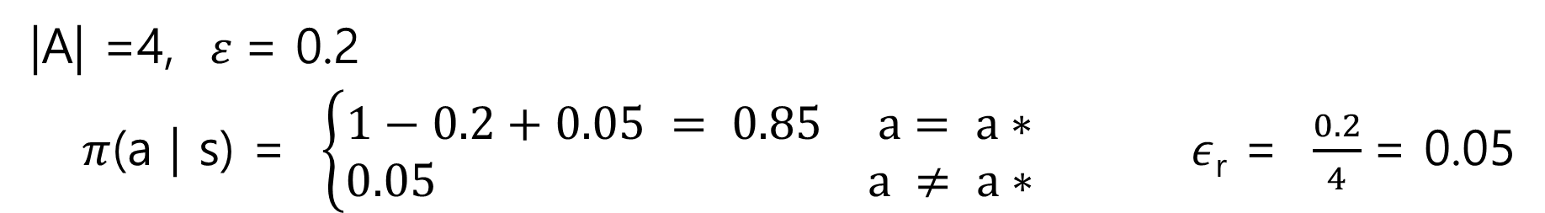
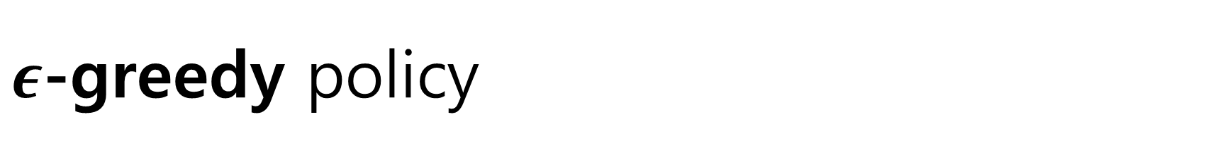
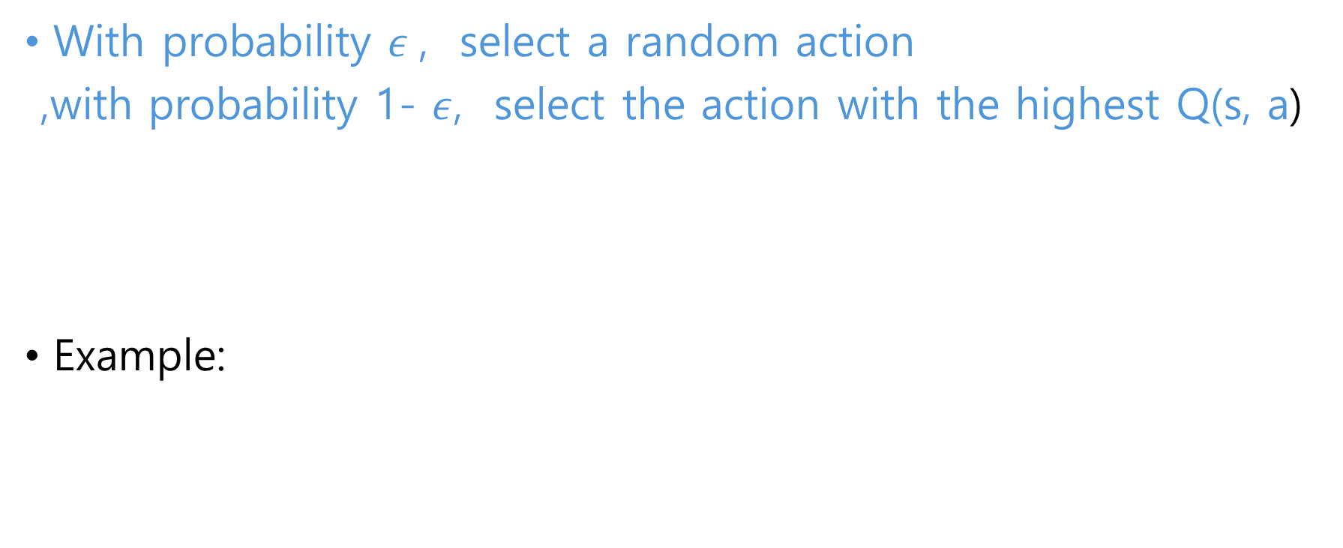
$ε$-greedy policy
With probability $ε$, select a random action
,with probability 1- $ε$, select the action with the highest Q(s, a)
Example:
Notes:
Highest Q의 action을 선택할 확률이 1-epsilon 인데, 그 action이 random하게 선택될 수도 있으니, 그 확률만큼 더해준다.

Slide 30
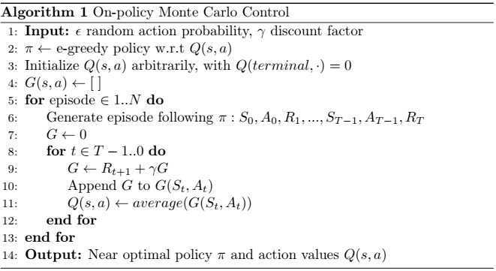
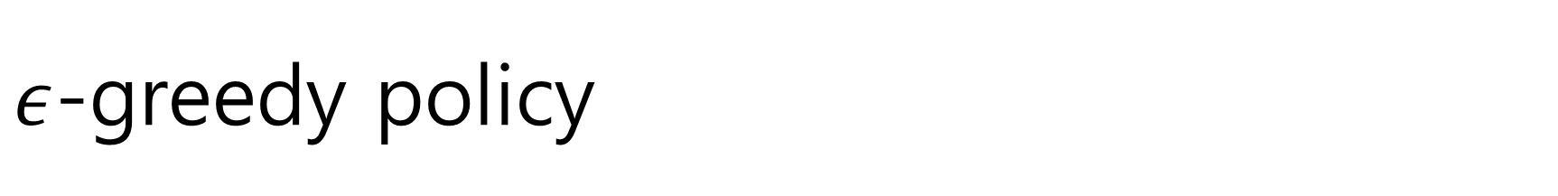
$ε$-greedy policy

Slide 31
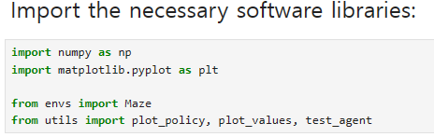
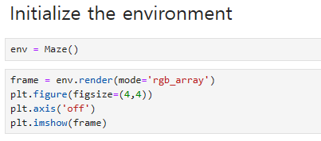
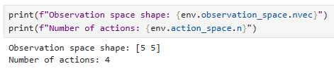
On-policy Monte Carlo Control

Slide 32
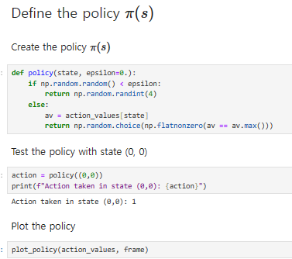
On-policy Monte Carlo Control

Slide 33
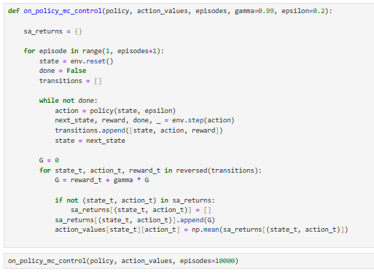
On-policy Monte Carlo Control

Slide 34
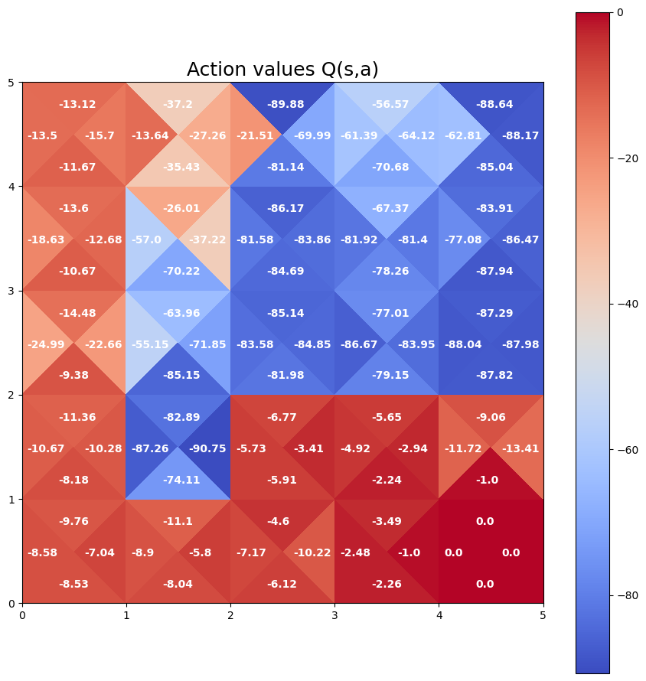
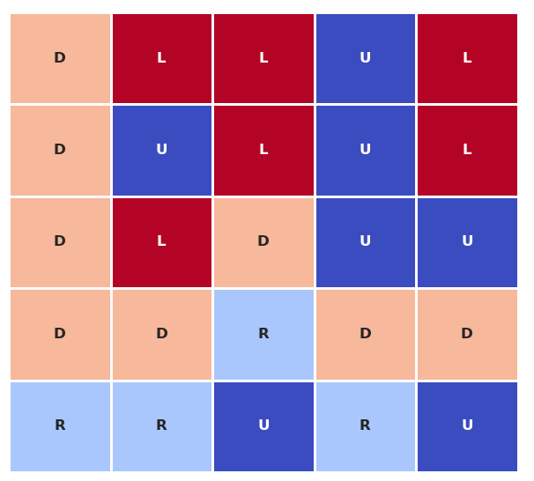
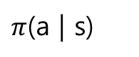
On-policy Monte Carlo Control
States off from the optimal path were not updated much
Optimal actions are the ones that lead us straight to the goal (on the optimal path)
$π$(a | s)
Q(s, a)

Slide 35
Code Ex.
Open ‘on_policy_control.ipynb’ with jupyter notebook

Slide 36
Off-policy Monte Carlo

Slide 37
Problem with On-policy strategy
Note On-policy strategy has no REUSE.
It collects episode, use it to update, and throw it away.
Data inefficient. Could we reuse old data ?
Besides, in practice there’s need for parallel learning, where a group of agent has a common behavior policy but each agent has a different target policy to update their own experience differently (or to pursue multiple optimal solutions)

Slide 38
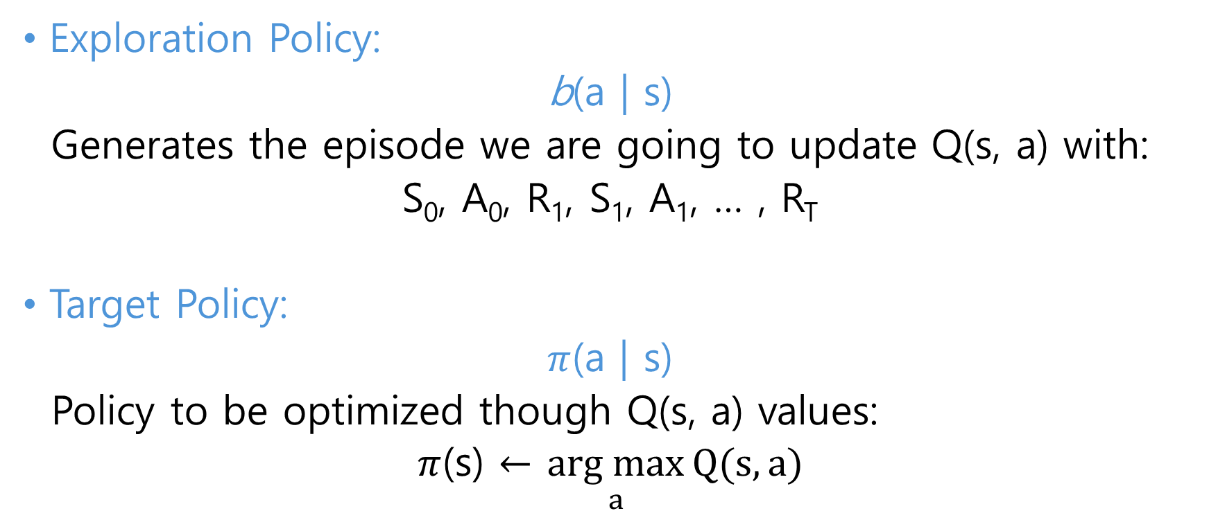
Off-policy strategy
Exploration Policy:
b(a | s)
Generates the episode we are going to update Q(s, a) with:
S₀, A₀, R₁, S₁, A₁, … , R_{T}
Target Policy:
$π$(a | s)
Policy to be optimized though Q(s, a) values:
$π$(s) $←$ $\underset{a}{arg max}{Q(s, a)}$

Slide 39
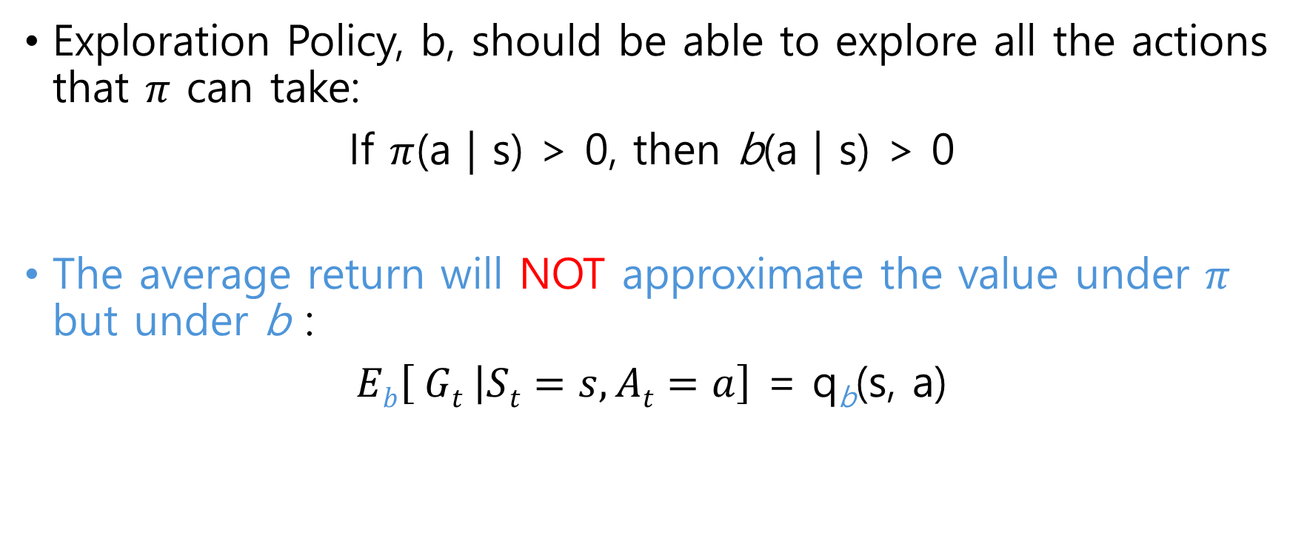
Off-policy strategy
Exploration Policy, b, should be able to explore all the actions that $π$ can take:
If $π$(a | s) > 0, then b(a | s) > 0
The average return will NOT approximate the value under $π$ but under b :
$Eb\left[ Gt | St=s, At=a\right]$ = q_{b}(s, a)

Slide 40
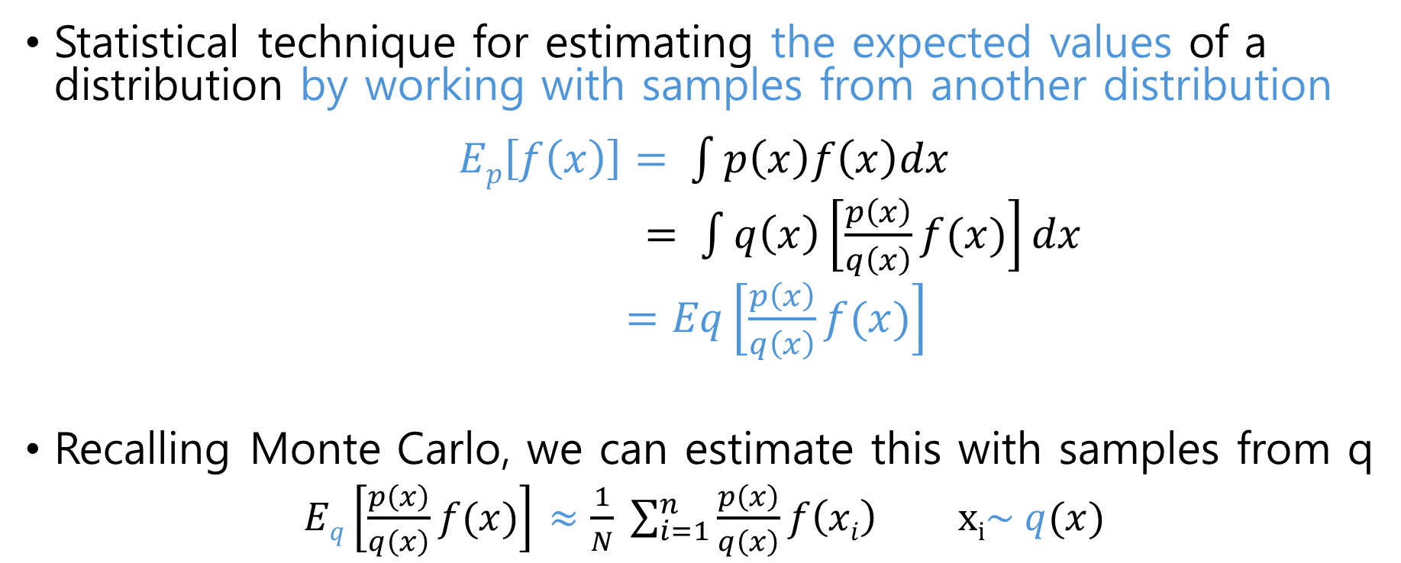
Importance sampling
Statistical technique for estimating the expected values of a distribution by working with samples from another distribution
$Ep\left[f\left(x\right)\right]= \int{p\left(x\right)f\left(x\right)dx}$
$= \int{q\left(x\right)\left[\frac{p\left(x\right)}{q\left(x\right)}f(x)\right]dx}$
$=Eq\left[\frac{p\left(x\right)}{q\left(x\right)}f(x)\right]$
Recalling Monte Carlo, we can estimate this with samples from q
$Eq\left[\frac{p\left(x\right)}{q\left(x\right)}f(x)\right]$ $≈\frac{1}{N} \sum_{i=1}^{n}{\frac{p\left(x\right)}{q\left(x\right)}f\left(xi\right)} xi\sim q(x)$

Slide 41
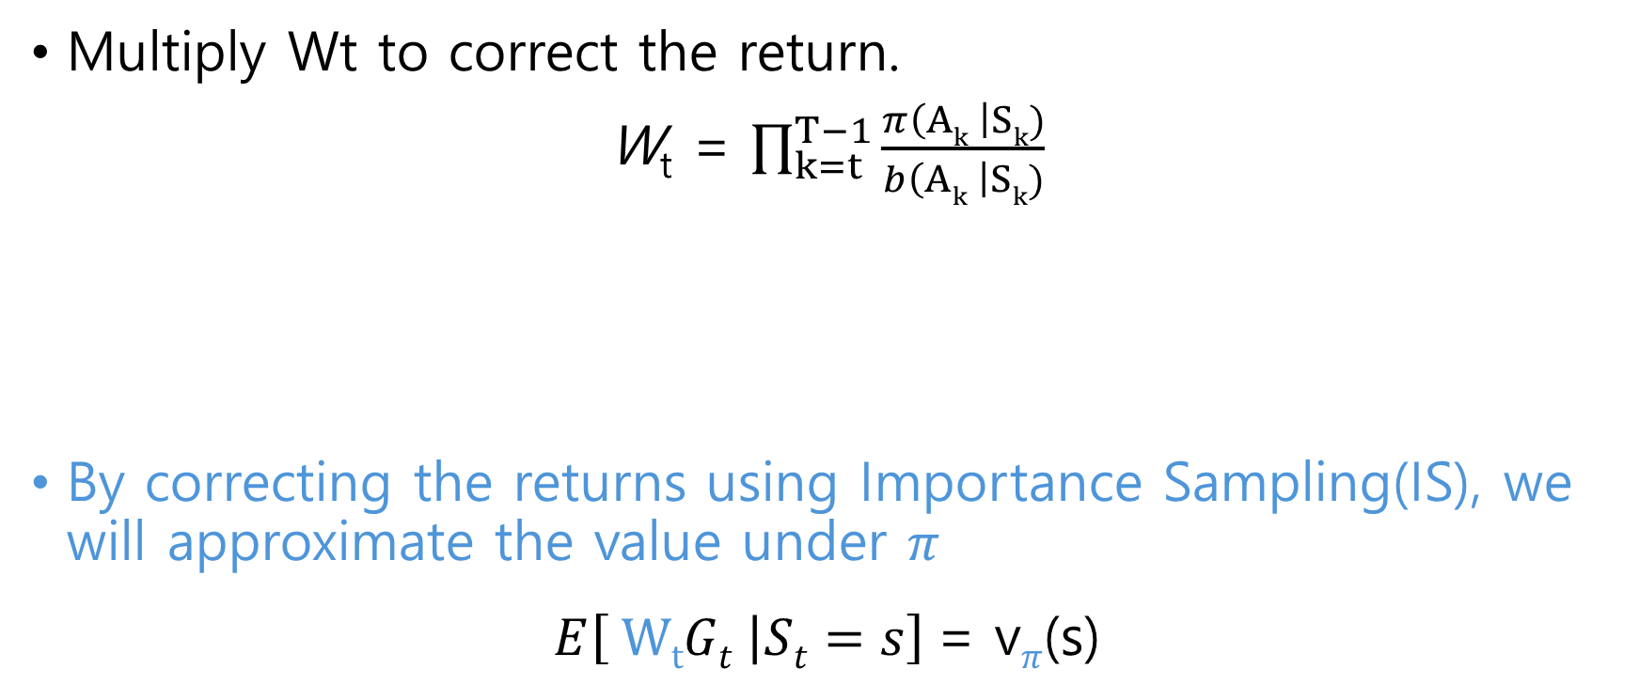
Importance sampling
Multiply Wt to correct the return.
W_{t} = $\prod_{k=t}^{T−1}{\frac{π\left(Ak \right|Sk)}{b\left(Ak \right|Sk)}}$
By correcting the returns using Importance Sampling(IS), we will approximate the value under $π$
$E\left[ WtGt | St=s\right]$= v$π$(s)
the prob. of generating the trajectory that produced that return following the target policy, divided by the prob. of generating that return, following the exploratory

Slide 42
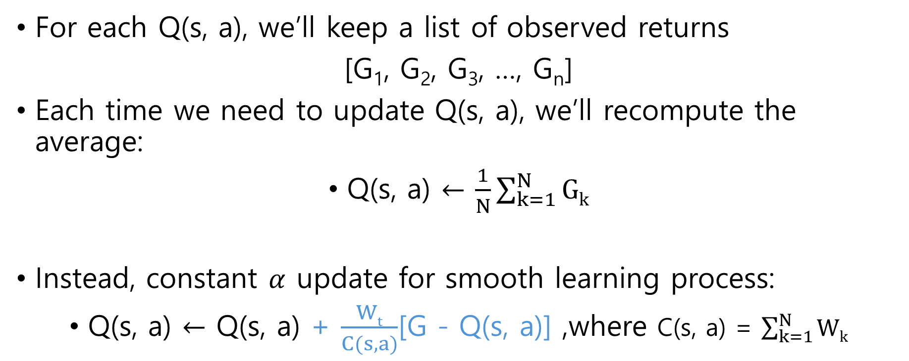
Update rule
For each Q(s, a), we’ll keep a list of observed returns
[G₁, G₂, G₃, …, G_{n}]
Each time we need to update Q(s, a), we’ll recompute the average:
Q(s, a) $←$ $\frac{1}{N}\sum_{k=1}^{N}{Gk}$
Instead, constant $α$ update for smooth learning process:
Q(s, a) $←$ Q(s, a) + $\frac{Wt}{C(s, a)}$[G - Q(s, a)] ,where C(s, a) = $\sum_{k=1}^{N}{Wk}$

Slide 43
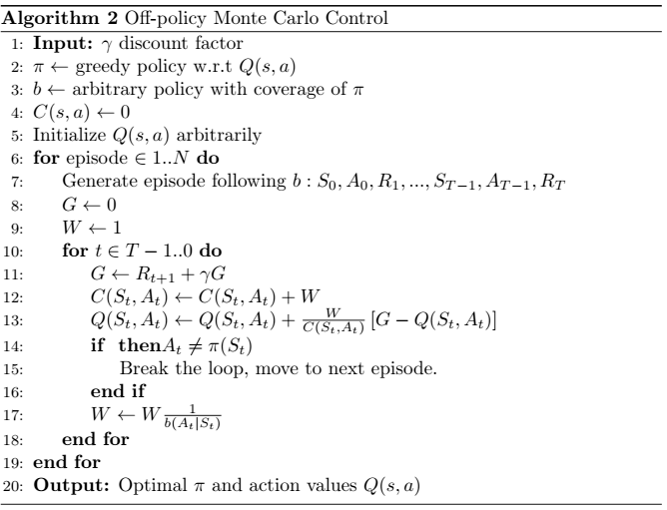
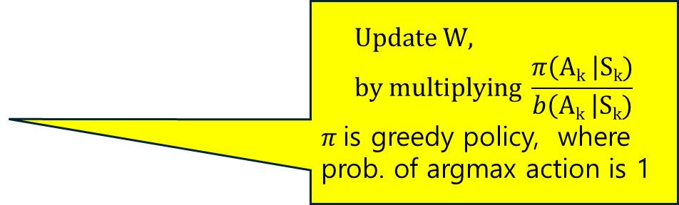
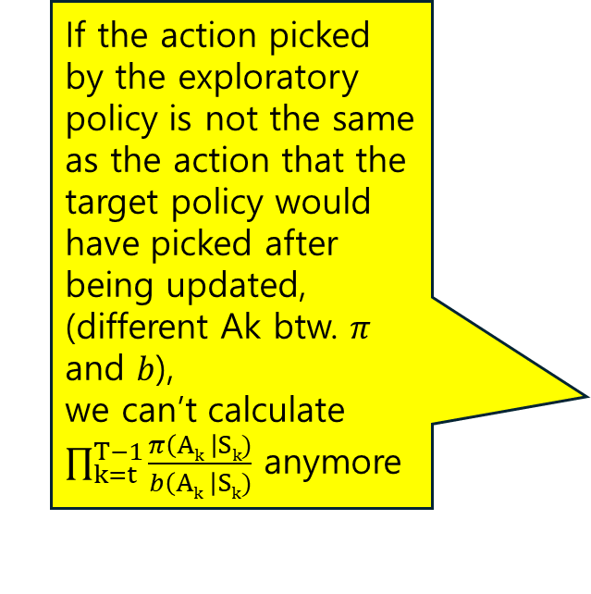
If the action picked by the exploratory policy is not the same as the action that the target policy would have picked after being updated,
(different Ak btw. $π$ and $b$),
we can’t calculate $\prod_{k=t}^{T−1}{\frac{π\left(Ak \right|Sk)}{b\left(Ak \right|Sk)}}$ anymore
$$Update W, by multiplying \frac{π\left(Ak \right|Sk)}{b\left(Ak \right|Sk)}$$
$π$is greedy policy, where prob. of argmax action is 1

Slide 44
Off-policy Monte Carlo Control

Slide 45
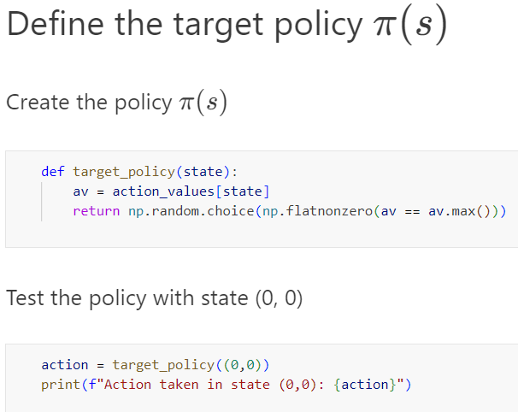
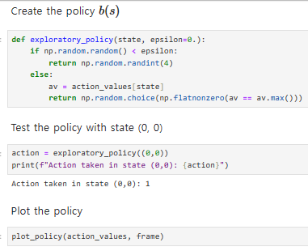
Off-policy Monte Carlo Control

Slide 46

Off-policy Monte Carlo Control

Slide 47


Off-policy Monte Carlo Control
The algorithm hasn’t spent much time and effort in refining the estimates of those states that do not lead to the goal(Ignored states on suboptimal paths)
Optimal actions are the ones that lead us straight to the goal (highest value than on-policy

Slide 48

Off-policy Monte Carlo Control
Recall Dynamic Programing sweeps through the whole states space, improving each and every one of them.
Although that give us the optimal policy and q-table, it’s extremely inefficient because we are wasting a lot of time in states that won’t help us achieve our goals
One of advantages of using methods to learn based on experience is that we can focus or efforts on states and actions that lead us to solving the task in the optimal way
For the states that do lead us to the goal, the optimal actions have the highest values
$O$ur algorithm didn’t spend much effort refining the estimates of those state that do not lead to the goal

Slide 49
Code Ex.
Open ‘off_policy_control.ipynb’ with jupyter notebook

